Slide 1

Design and Development of a Music Streaming Application Database
Team members:-
Pavan Madhav Manikantha Sai Nainala
Srikanth Chilaka
Bhuvana Ravikumar
Sravani Pabbu

Slide 2

Problem statement
The music streaming industry is highly competitive, with numerous platforms vying for user engagement. The problem we are facing is to keep the user pact, recommendation system needs to be improved and for that the user personalized playlist based on their prior engagement with the music their, liking towards the music genre needs to be considered for that How we collect the database and utilizes it matters and our project aims for that.

Slide 3

Solution Strategy
Personalized song recommendation
Competitive edge through unique playlist recommendation
Efficient tracking of song play history

Slide 4

Objective
Personalization and User Engagement: In today’s digital era one size fit all will not workout, so user recommendation needs to be tailored to individual tastes and preferences.
User Retention: User who discover new music and likes it are more likely to be engaged with the music. So we aim to find a way to keep the user back by offering the relevant content.
Data Tracking and Analysis: analyzing the user behavior is one of the key point to improve the application. We must be able to track user interactions, such as song plays, likes, and playlist creations, to gain insights into user preferences and habits.
User Satisfaction: Ultimately, user satisfaction is the foundation of a successful music streaming platform. Users should find the application easy to use, enjoyable, and responsive to their music preferences.

Slide 5
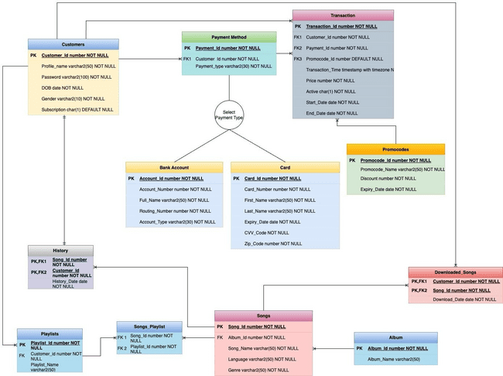

ER diagram

Slide 6

Database Tables
Customer
Payment Method
Transaction
Bank Account
Card
Promo Code
History
Playlist
Songs
Album
Downloaded songs
Songs playlist

Slide 7
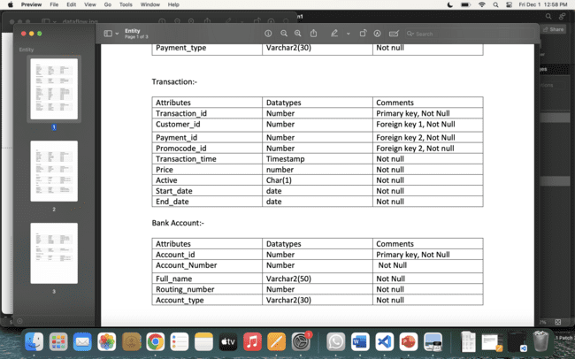
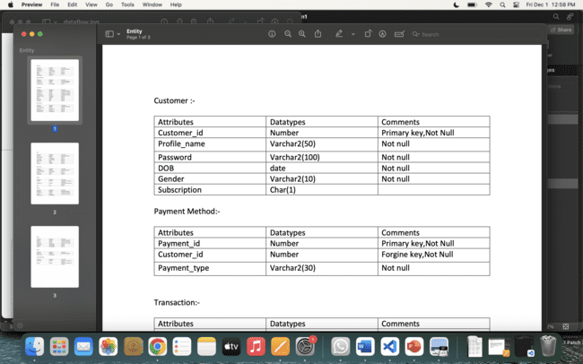
Attributes and Entity

Slide 8
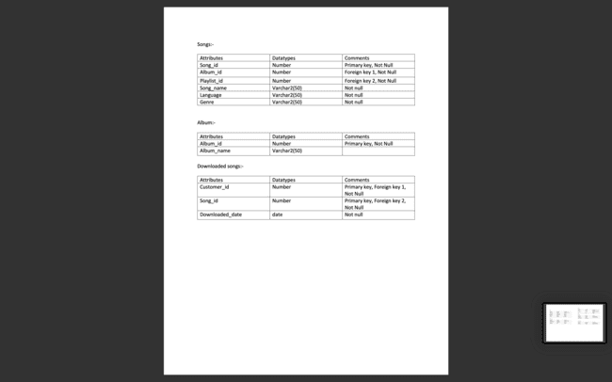
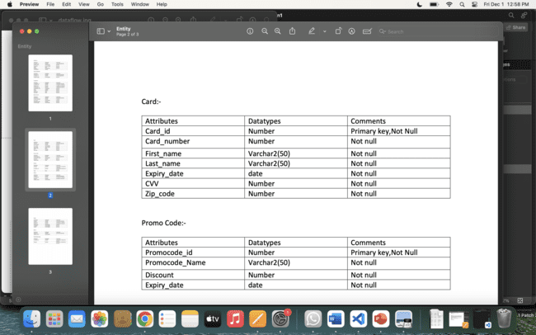

Slide 9
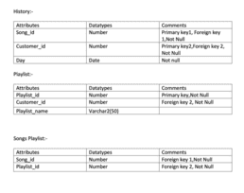

Slide 10

Overview:- Business rules
User can create customer account
User can access to their personal recommendations
User can use the application with subscription also without subscription
User can create their own playlist
User can subscribe by paying with their card or from Bank transfer
User can also use promocode if its valid they will get discount for the transaction
User can download the song if only they have subscription
User can see their listened history
User won’t be able to edit song or album table
Admin will have access to all the tables

Slide 11
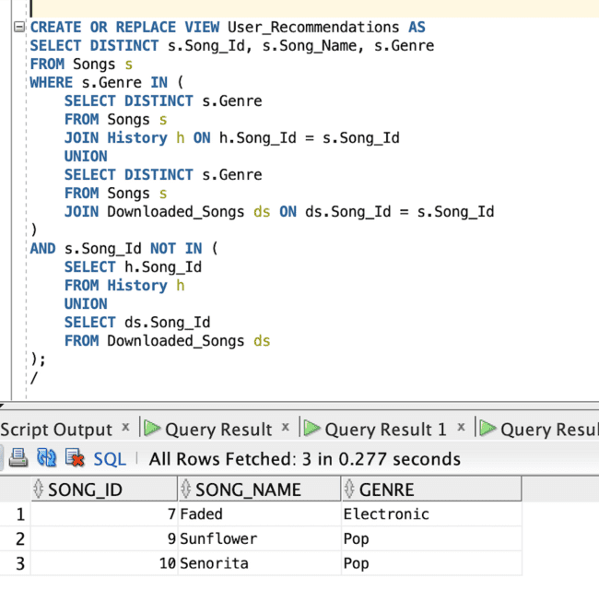
Views and packages
User recommendations on whole customers

Slide 12
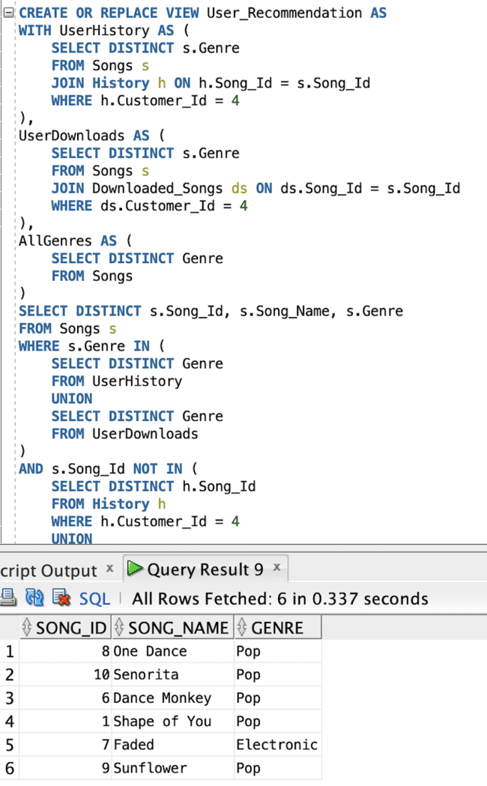
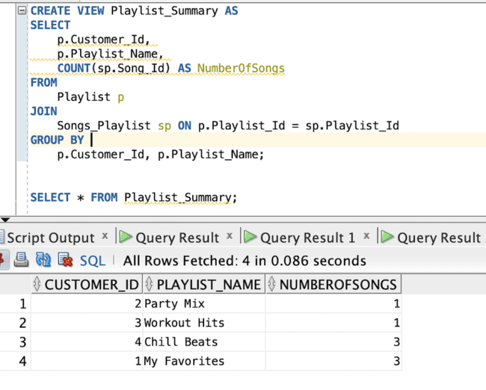
Songs in Playlist
User Recommendation for each cusstomer

Slide 13
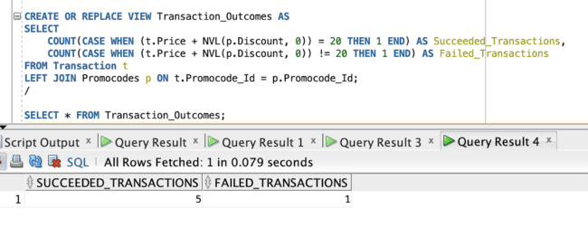
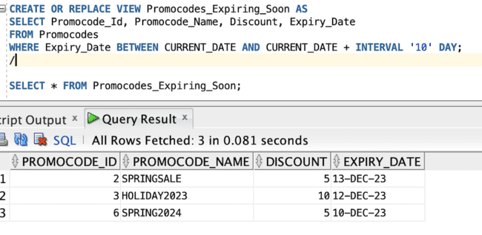
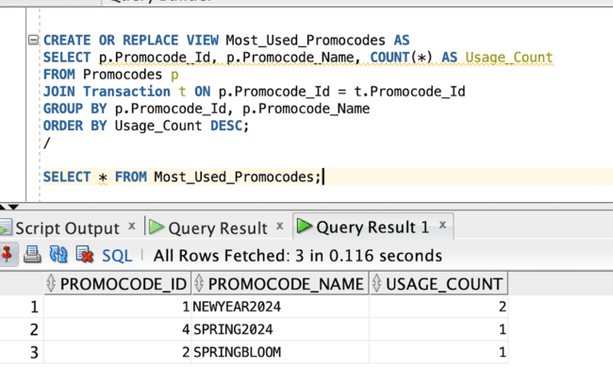
Type of transactions
Promocodes expiring in 10 days
Most_Used_Promocodes

Slide 14
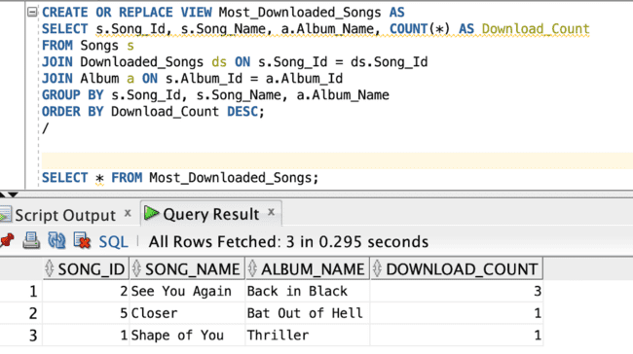
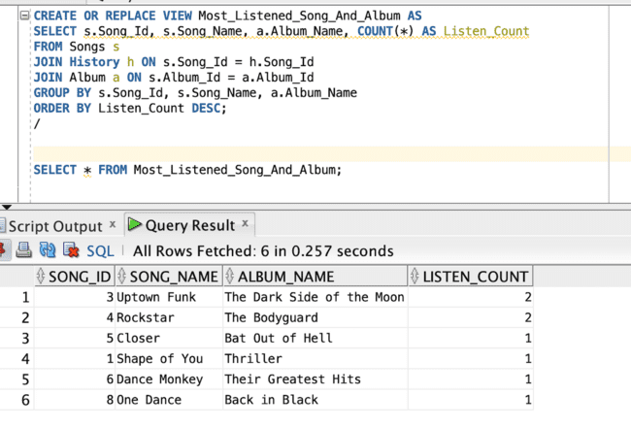
Most_Downloaded_Songs
Most_Listened_Songs

Slide 15
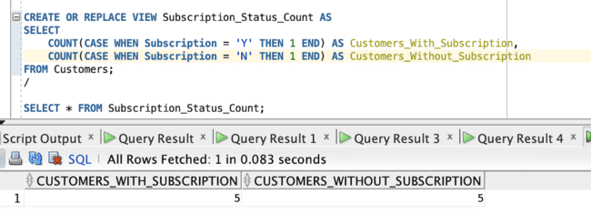
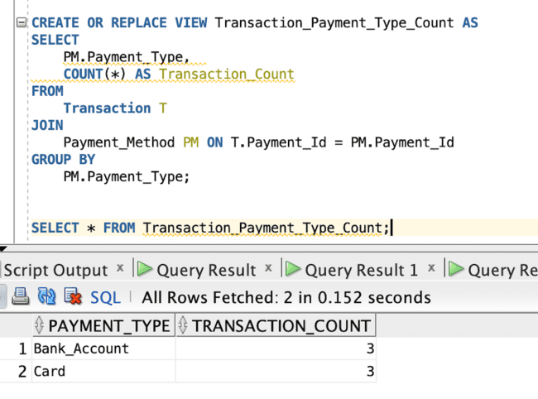
customers with and without subscription
count of payment type transactions

Slide 16
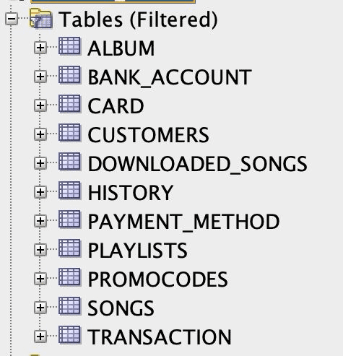
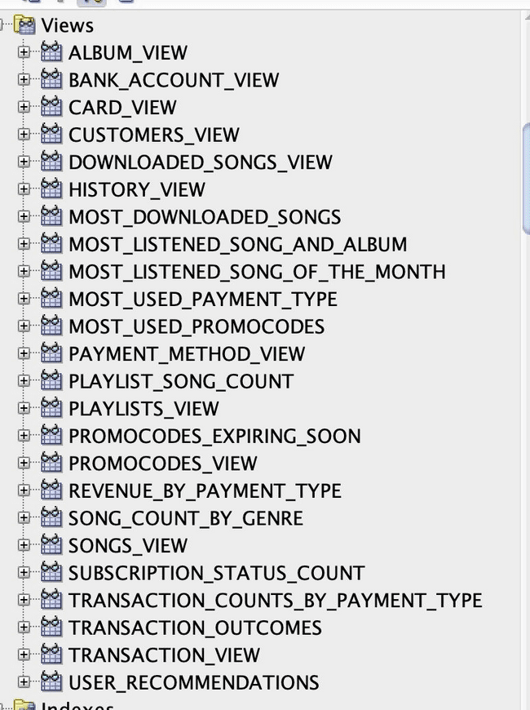
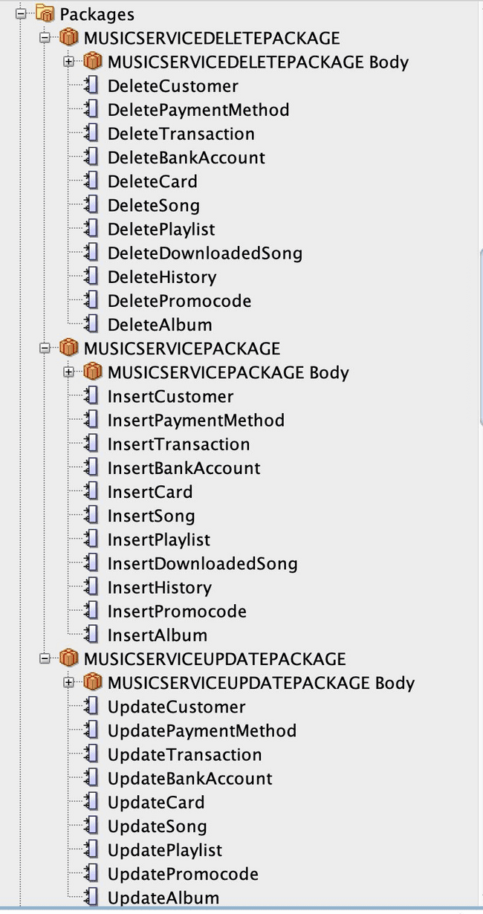
Table
Views
Packages

Slide 17

Team members contribution
Madhav
Insert Customer,Update Customer,DeleteCustomer,InsertPaymentMethod,UpdatePaymentMethod
Srikanth
InsertPaymentMethod,UpdatePaymentMethod,DeletePaymentMethod,InsertTransaction,UpdateTransaction
Bhuvana
Insert Song, Update Song, Delete Song, Insert Playlist, Update Playlist
Sravani
UpdateAlbum,DeleteAlbum,create and delete views,create and delete users
DeletePaymentMethod,InsertTransaction,UpdateTransaction,DeleteTransaction
DeleteTransaction,InsertBankAccount,UpdateBankAccount,DeleteBankAccount,InsertCard,UpdateCard,DeleteCard
DeletePlaylist,InsertDownloadedSong,DeleteDownloadedSong,InsertHistory,DeleteHistory
InsertPromocode,UpdatePromocode,DeletePromocode,InsertAlbum,

Slide 18

Thank you!!

